Slide 1

programming a game
Group 13:
Luca Pinggera, Matthias Schenk, Nikhil Sethukumar, Ziruo Xiao
With inputs from
Velko Vechev, Andreas Fender, Tiffany Luong
Human Computer Interaction
Fall 2022
Zürich
14 Dec 2022

Slide 2
AGENDA
Introduction​
Low and Mid-fi prototypes
Hi-fi prototype
Statistical Analysis
​Conclusion

Slide 3
Introduction
Topic: Programming.
To introduce programming concepts to beginners.

Slide 4
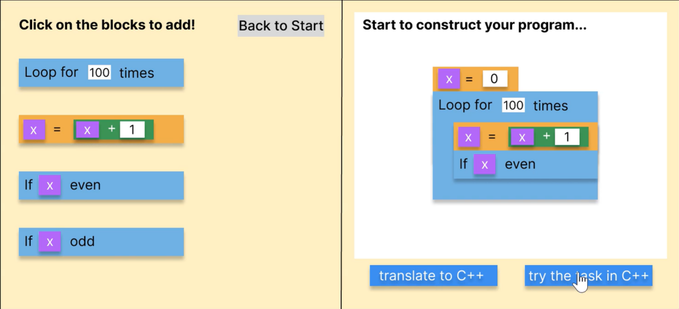
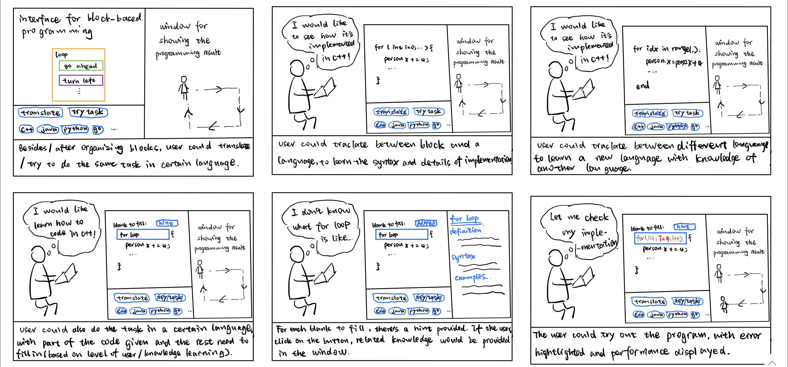
Low and Mid-fi prototypes

Slide 5
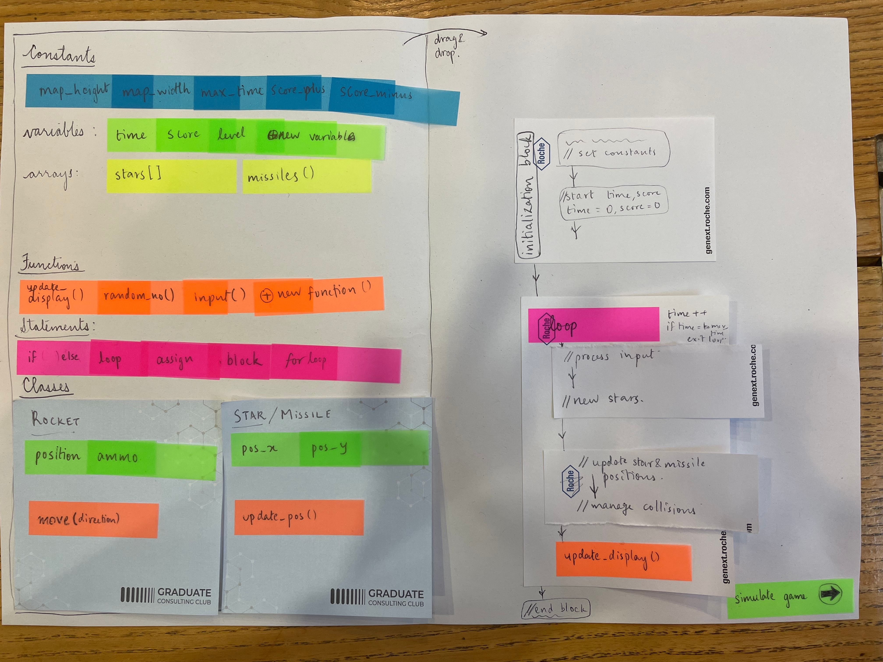
Low and Mid-fi prototypes

Slide 6
Hifi prototype
block-based coding environment
teaches core programming concepts to beginners
programming a rudimentary game

Slide 7
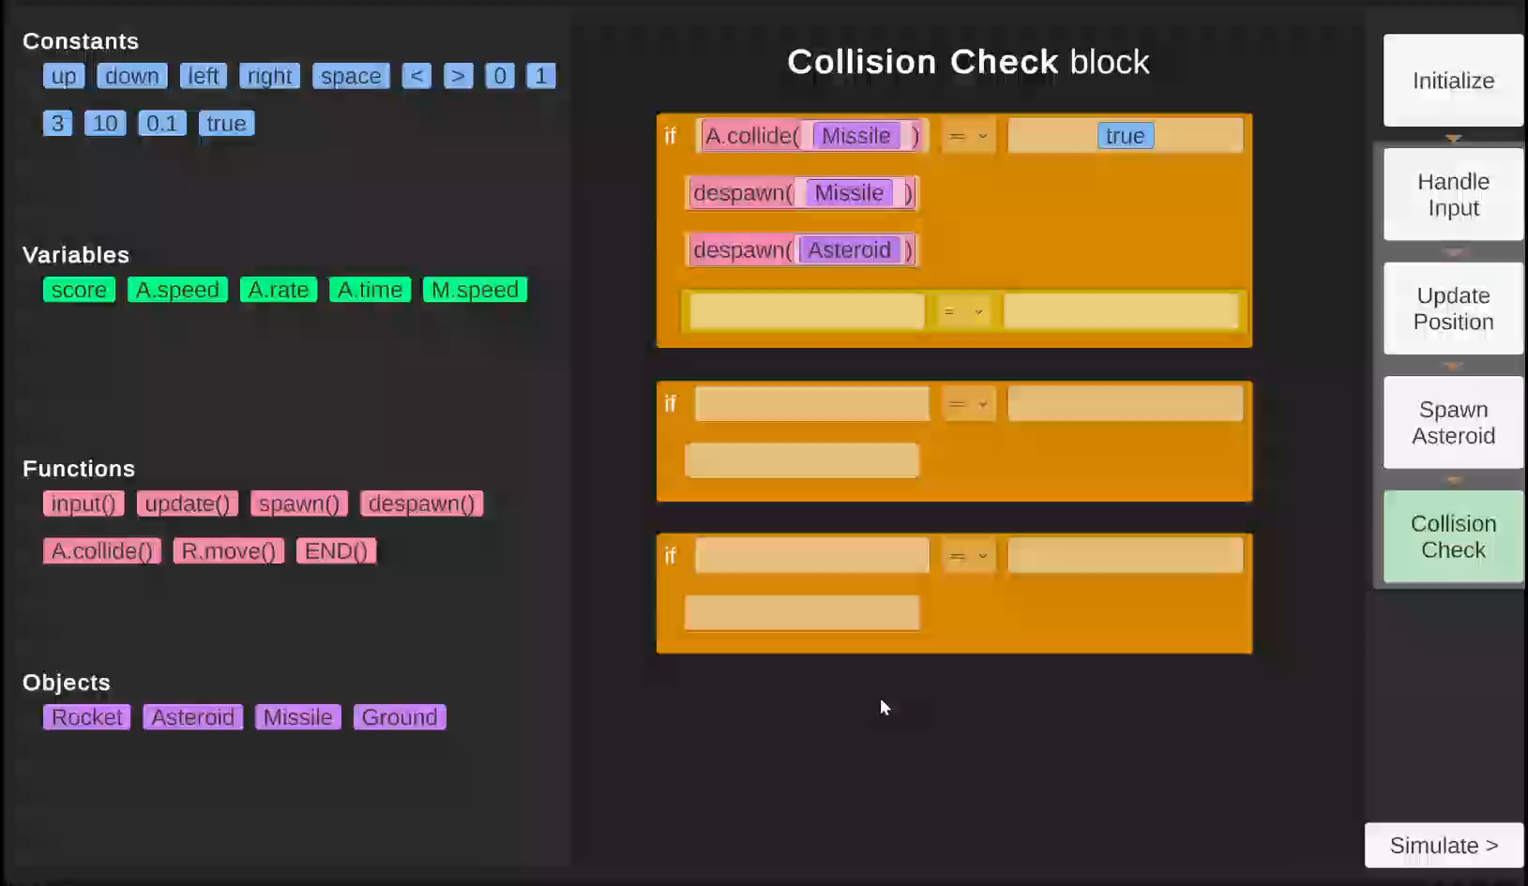
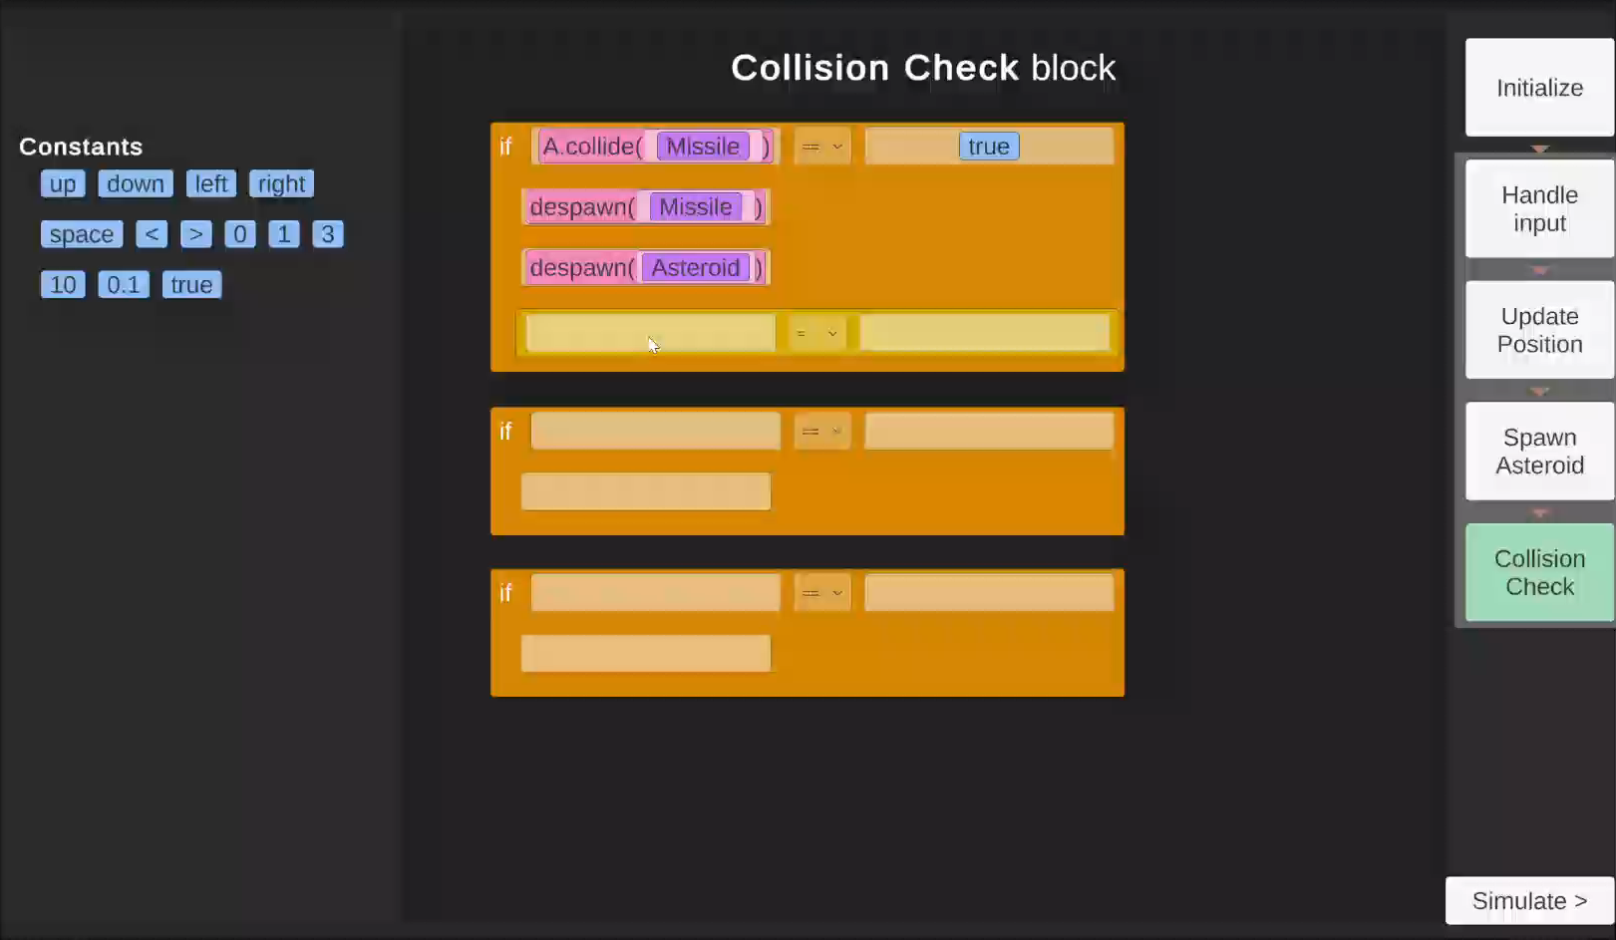
Prototype a
Prototype B

Slide 8
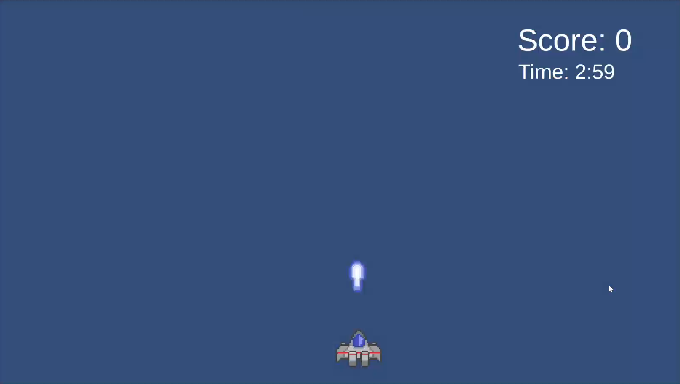
Game

Slide 9
Statistical analysis
Hypothesis 1: There will be no effect of the block selection interface on the users perceived ease of use.
Hypothesis 2: There will be no effect of the block selection interface on the task completion time.
Hypothesis 3: There will be no effect of the block selection interface on the number of clicks the user does.
User study Goal
Complete one block of code, given how it should finally look.
Results
(8 participants)

Slide 10
Conclusion
Prototype A had faster completion time and fewer required clicks for the task completion with no significant impact on ease of use.

Slide 11


